Slide 1
CS Studio

Slide 2
Report 26.08.05
Suggested
Existing example should be improved
Make as an object, create a template which has 4 values FPGA temp, SiPM temp, Bias Set | RBV | STATE, voltage values -> STATE should be defined the colour of voltage if the difference between voltage bigger than 0.6V should be red, less than 0.6 green) -> I used embedded display option then i use macro for each board, it is easier than first one i did.
Try to use thermometer function for temperature values
Questions / Ideas
next to the thermometers may be alarms/status for them ?
thermometers colors / they dont show degree, i used them with text update.
also did Chamber name, detector, board number as title of board card (did it but then decided to name only „Board (BOARD_NUMBER)“

Slide 3
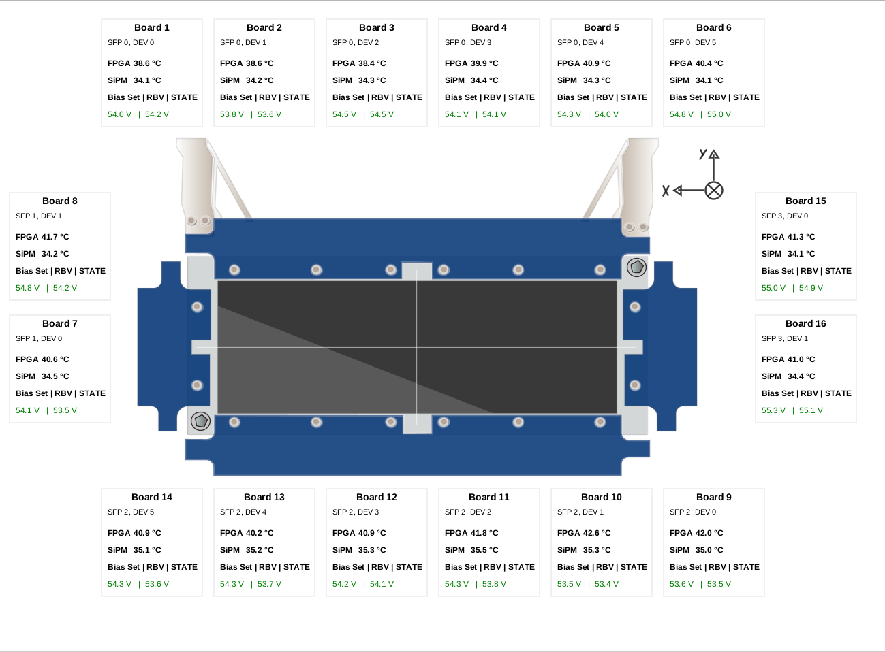
Example – Day 1

Slide 4
Report 26.08.06
Suggested
use .yaml file, create tabbs for each chamber, chamber titles should „CHAMBER_NAME-DETECTOR“,
for the first chamber (FPF2 SCIFI1) caput some values and test it
update the template to the last commit rule iraklis file (bias set, RBV STATE files etc.)
Questions / Ideas

Slide 5
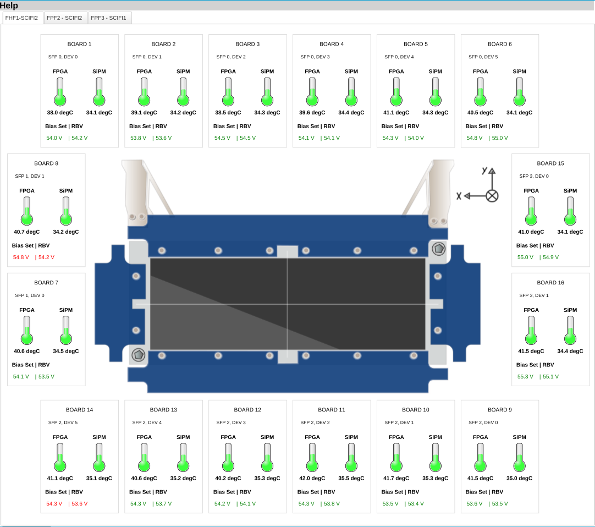

Example – Day 2

Slide 6
Report 26.08.10
Suggested
two tabs system, first detector name (scifi, plsci, music) -> chamber name, each one should have one embedded display should show the whole system
caput values for tests for the chambers that do not have any value (did it but then they were resetted)
update the template to the last commit rule iraklis file (bias set, RBV STATE files etc.)
Questions / Ideas

Slide 7
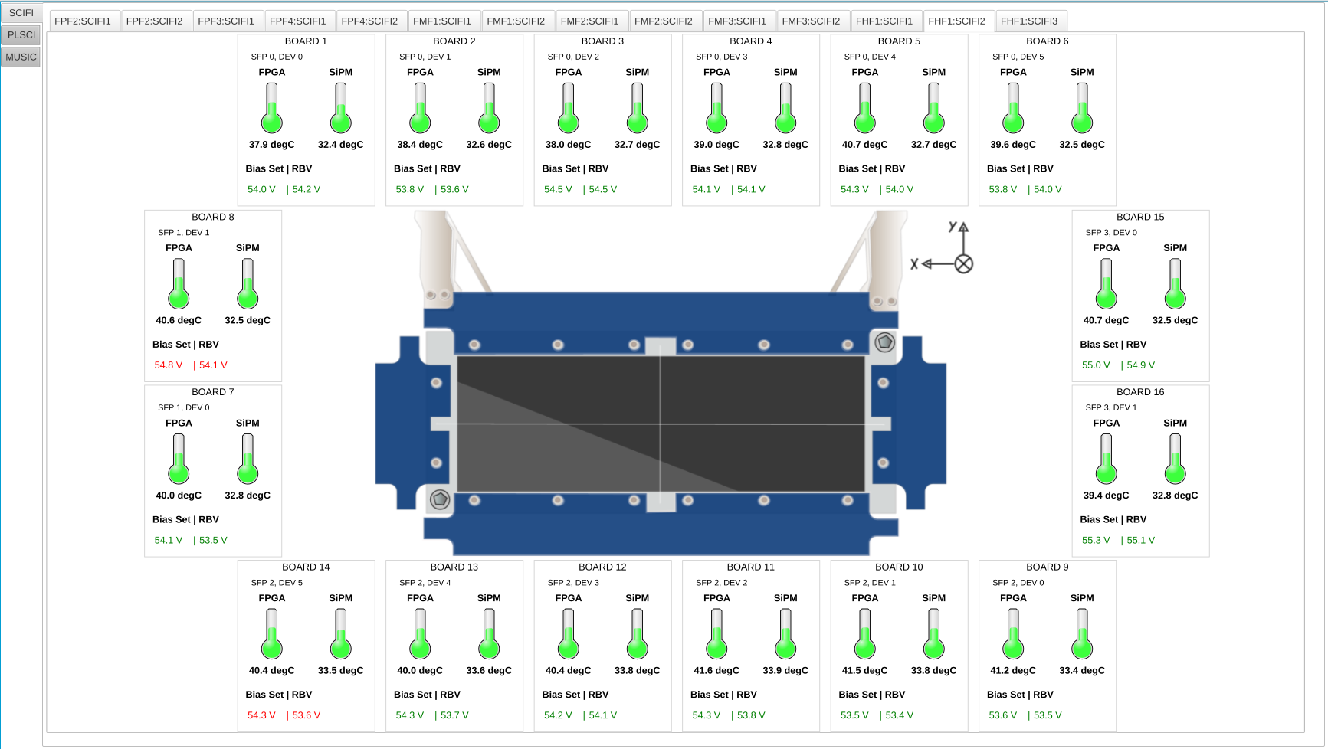
Example – Day 3

Slide 8
Report 26.08.11-12
Suggested
try some widgets
update the template to the last commit rule iraklis file (bias set, RBV STATE files etc.)
add and update values for FPF2
Questions / Ideas
multistate leds make error, warning, ok
thermometer alarm to the color (did it but limits set so far so every board looks green still)

Slide 9
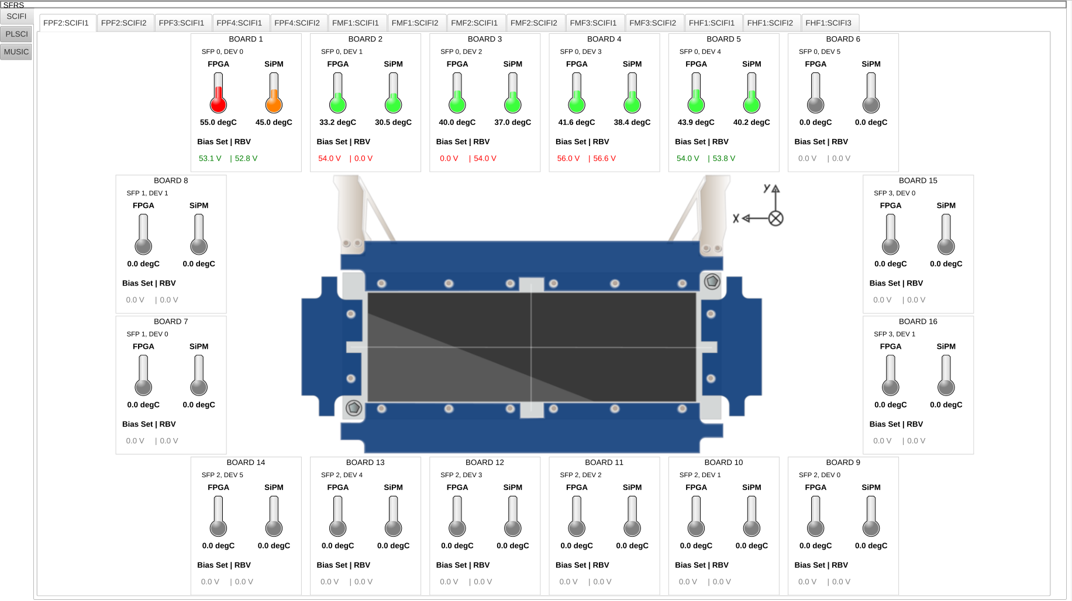
Example – Day 4-5

Slide 10
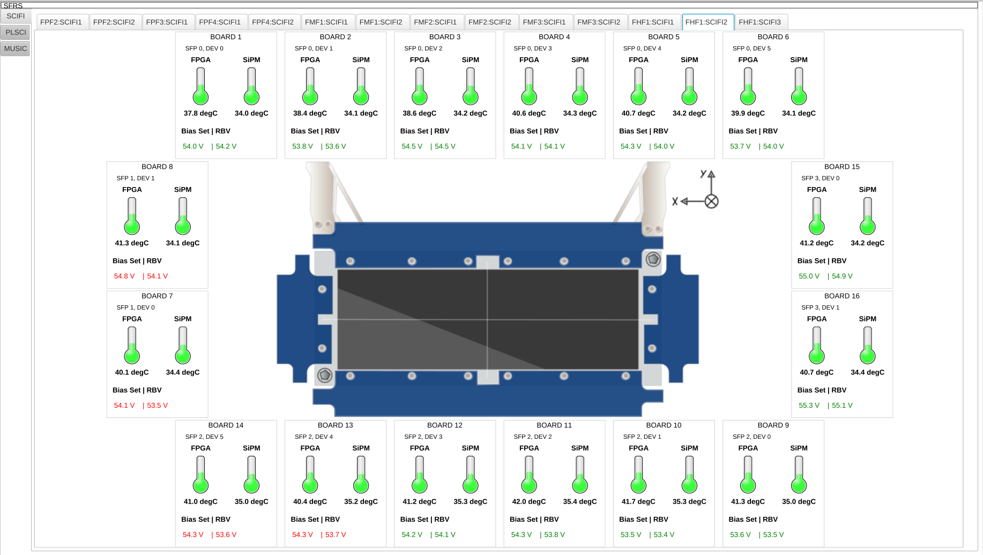
Example – Day 4-5

Slide 11
Report 26.08.13
Suggested
start with plsci / music
6 tabs for plsci, each tab:on/off led, HV linear meter, count rate meter (log scale)
for plsci 4 of them has 6 board, 2 of them has 8 board
2 tabs for music, each tab: field cage those field cage needs HV_SET, HV_RBV, HV_STAT
for music also there is gas ?
Questions / Ideas
multistate leds make error, warning, ok
Use log scale for Meter
for plsci it may be used tank/progress bar for HV_RBV
should gas be monitored for music?
PLSCI and SCIFI screen resolutions are different, is this a problem ?

Slide 12
Report 26.08.17
Suggested
start with plsci / music
6 tabs for plsci, each tab:on/off led, HV linear meter, count rate meter (log scale)
for plsci 4 of them has 6 board, 2 of them has 8 board
2 tabs for music, each tab: field cage those field cage needs HV_Ì_SET, HV_I_RBV, HV_STATE
for music also there is gas ?
Questions / Ideas
multistate leds make error, warning, ok
Use log scale for Meter
for plsci it may be used tank/progress bar for HV_I_RBV
should gas be monitored for music?
PLSCI and SCIFI screen resolutions are different, is this a problem ?

Slide 13
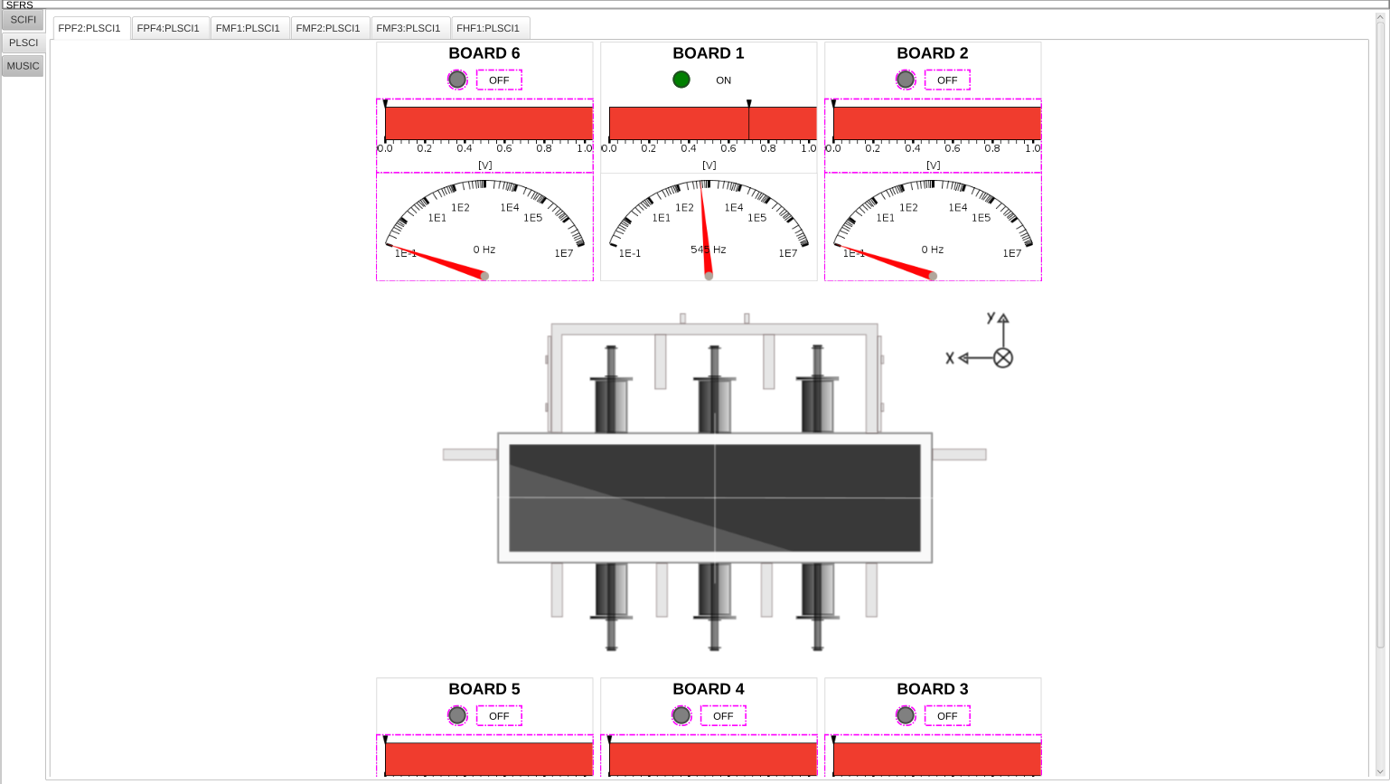
Example – Day 6-7

Slide 14
Report 26.08.18
Suggested
2 tabs for music, each tab: field cage those field cage needs HV_Ì_SET, HV_I_RBV, HV_STATE
music FC belov should on/off next to it Volt and current 2 linear meters, belove them state next to it byte monitor and belove them it should show the current sit and representativ situation
to think click a button to open a new tab
naming should change
Questions / Ideas
multistate leds make error, warning, ok
for plsci it may be used tank/progress bar for HV_I_RBV
PLSCI and SCIFI screen resolutions are different, is this a problem ? (new 1920x1440)

Slide 15
Report 26.08.19
Suggested
to think click a button to open a new tab
naming should change
button for on/off (MUSIC)
show V plot (MUSIC)
look text rule (MUSIC) it does not work now
make condition text entry and action button
Questions / Ideas
multistate leds make error, warning, ok
for plsci it may be used tank/progress bar for HV_I_RBV

Slide 16
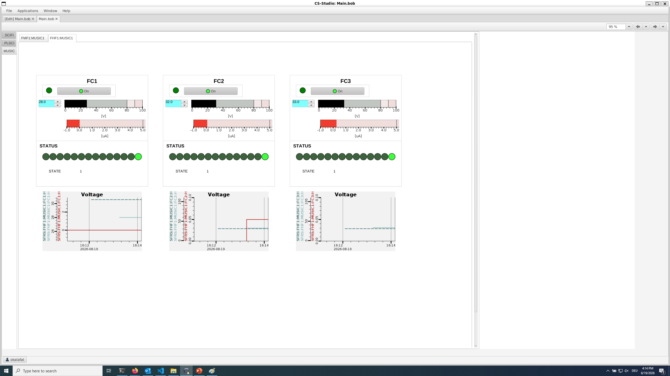
Example – Day 8-9

Slide 17
Report 26.08.20
Suggested
to think click a button to open a new tab
naming should change
button for on/off (MUSIC)
show V plot (MUSIC)
look text rule (MUSIC)
make condition text entry and action button
there will come one more HV for pos values
make settings file that will be automatized later when we have different layout ideas
Questions / Ideas
multistate leds make error, warning, ok
for plsci it may be used tank/progress bar for HV_I_RBV

Slide 18
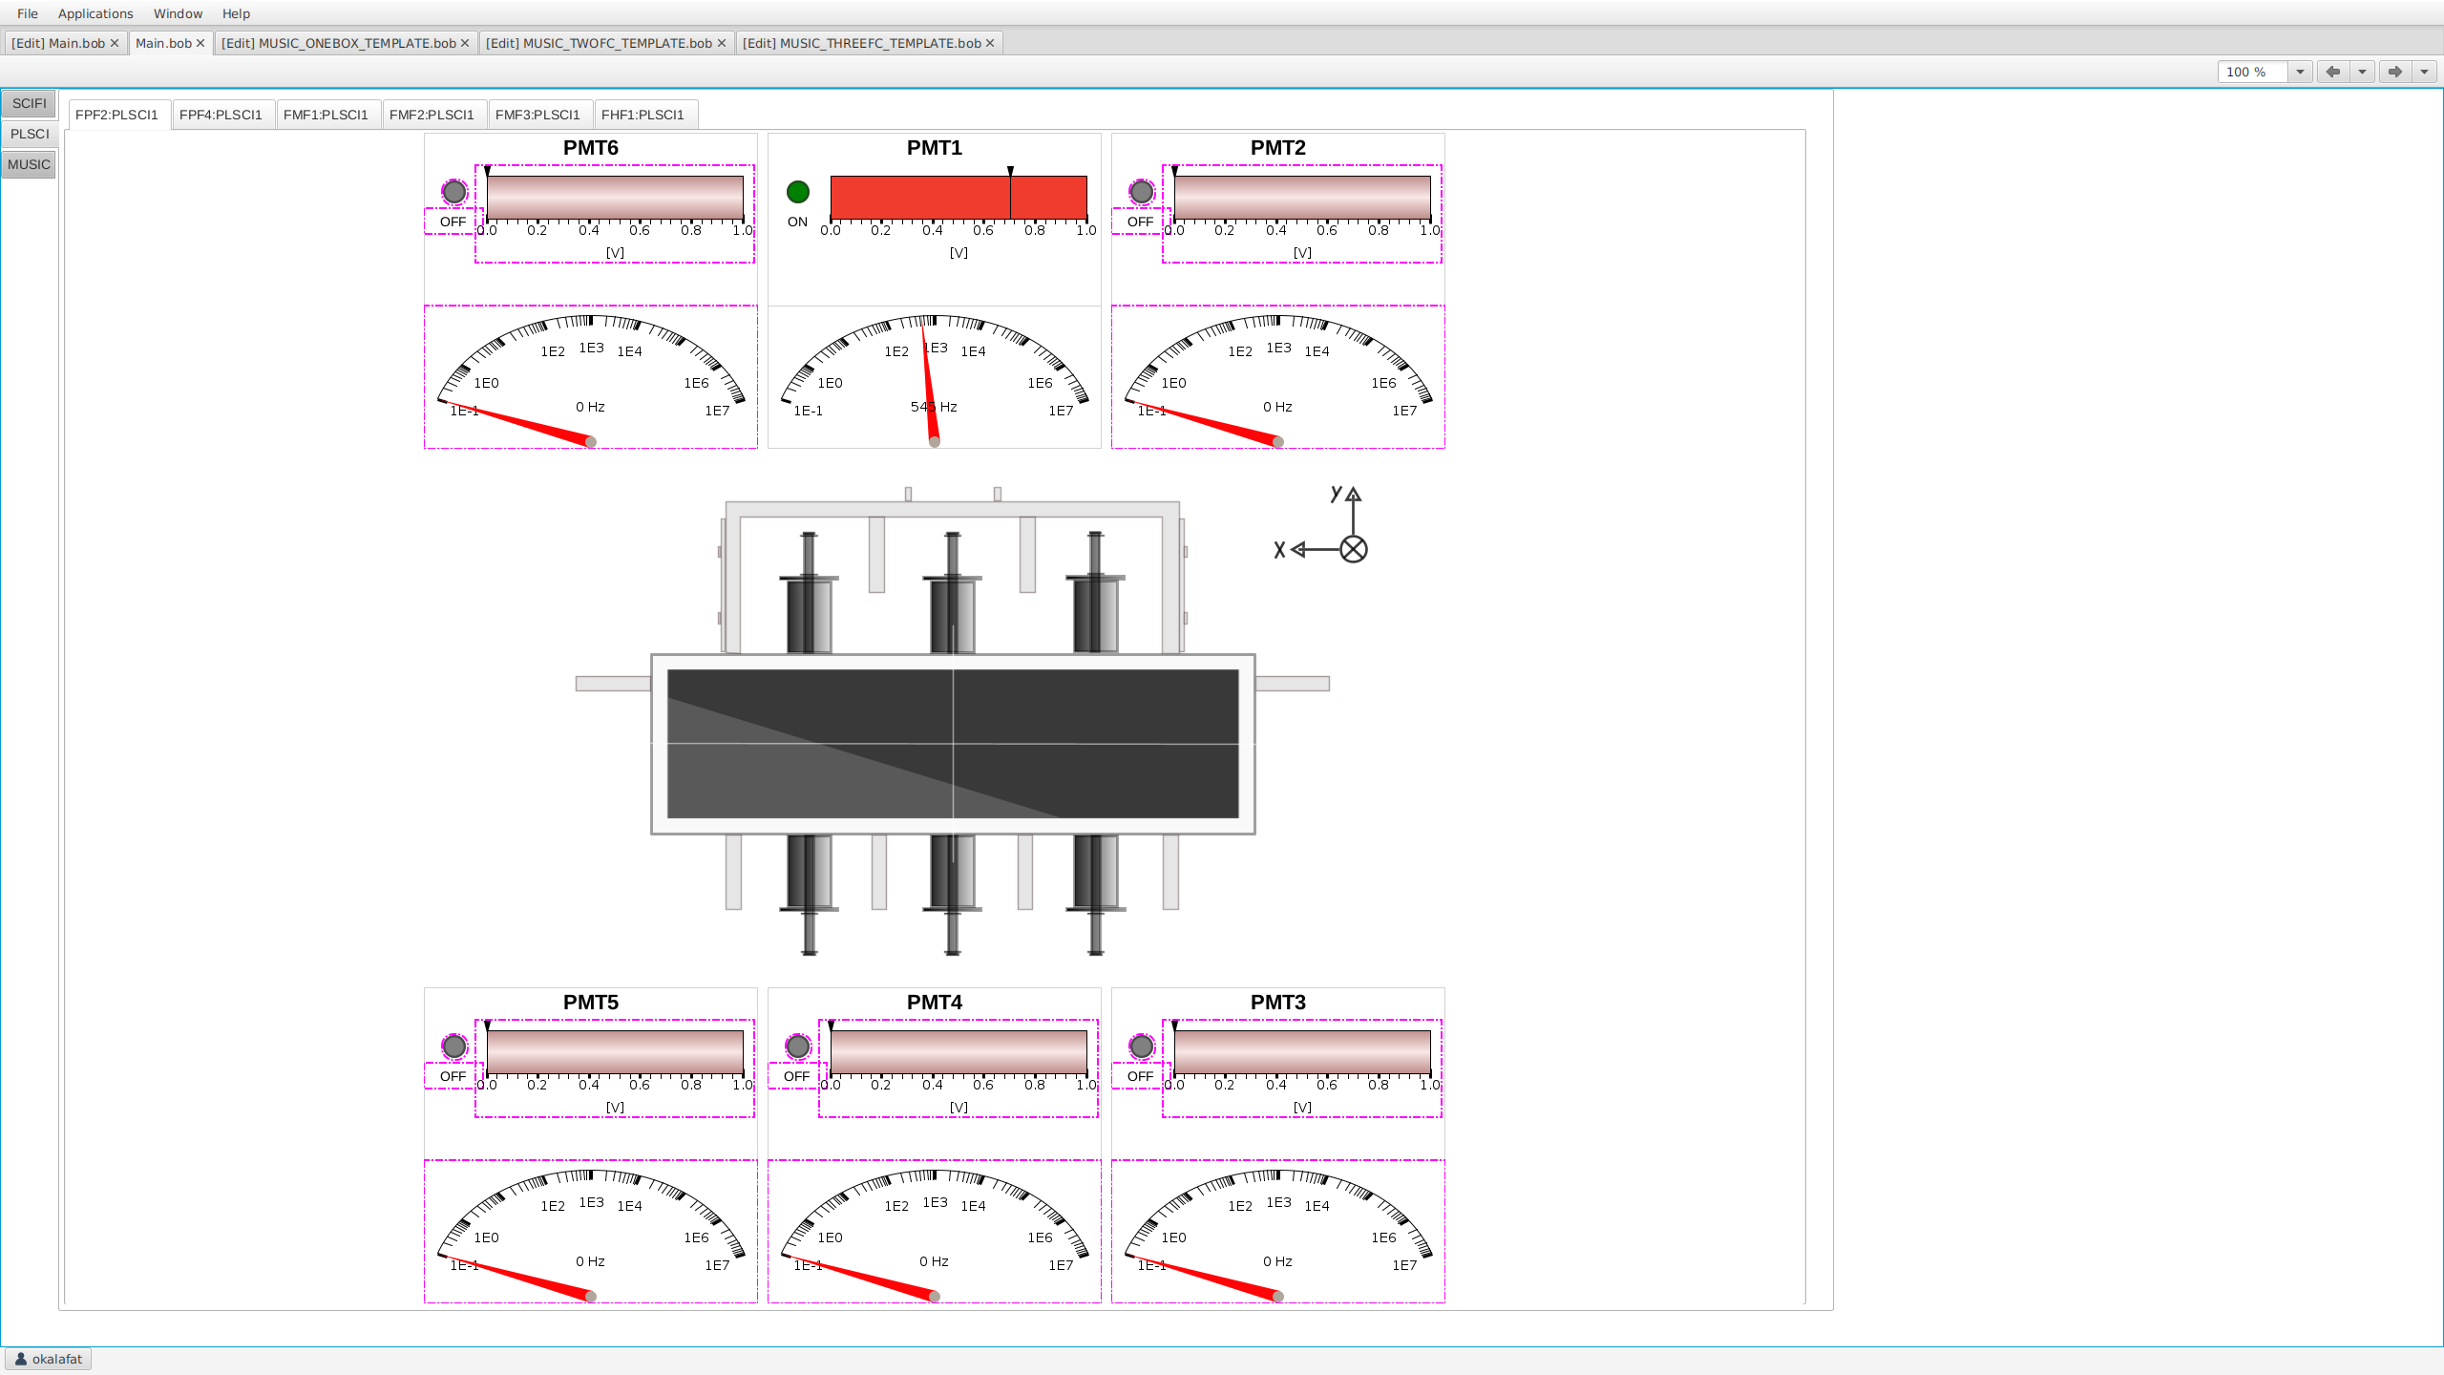
Example – Day 10

Slide 19
Report 26.08.24
Suggested
to think click a button to open a new tab
there will come one more HV for pos values
make settings file that will be automatized later when we have different layout ideas
naming and README files should be done like MUSIC
add set button for scifi bias set
Questions / Ideas
multistate leds make error, warning, ok
for plsci it may be used tank/progress bar for HV_I_RBV

Slide 20
Report 26.08.25
Suggested
to think click a button to open a new tab
there will come one more HV for pos values
make settings file that will be automatized later when we have different layout ideas
naming and README files should be done like MUSIC
add set button for scifi bias set
Questions / Ideas
multistate leds make error, warning, ok
for plsci it may be used tank/progress bar for HV_I_RBV

Slide 21
Report 26.08.26
Suggested
to think click a button to open a new tab
there will come one more HV for pos values
make settings file that will be automatized later when we have different layout ideas
naming and README files should be done like MUSIC
add set button for scifi bias set
meet with Irakli talk about feedbacks
Questions / Ideas
multistate leds make error, warning, ok
for plsci it may be used tank/progress bar for HV_I_RBV

Slide 22
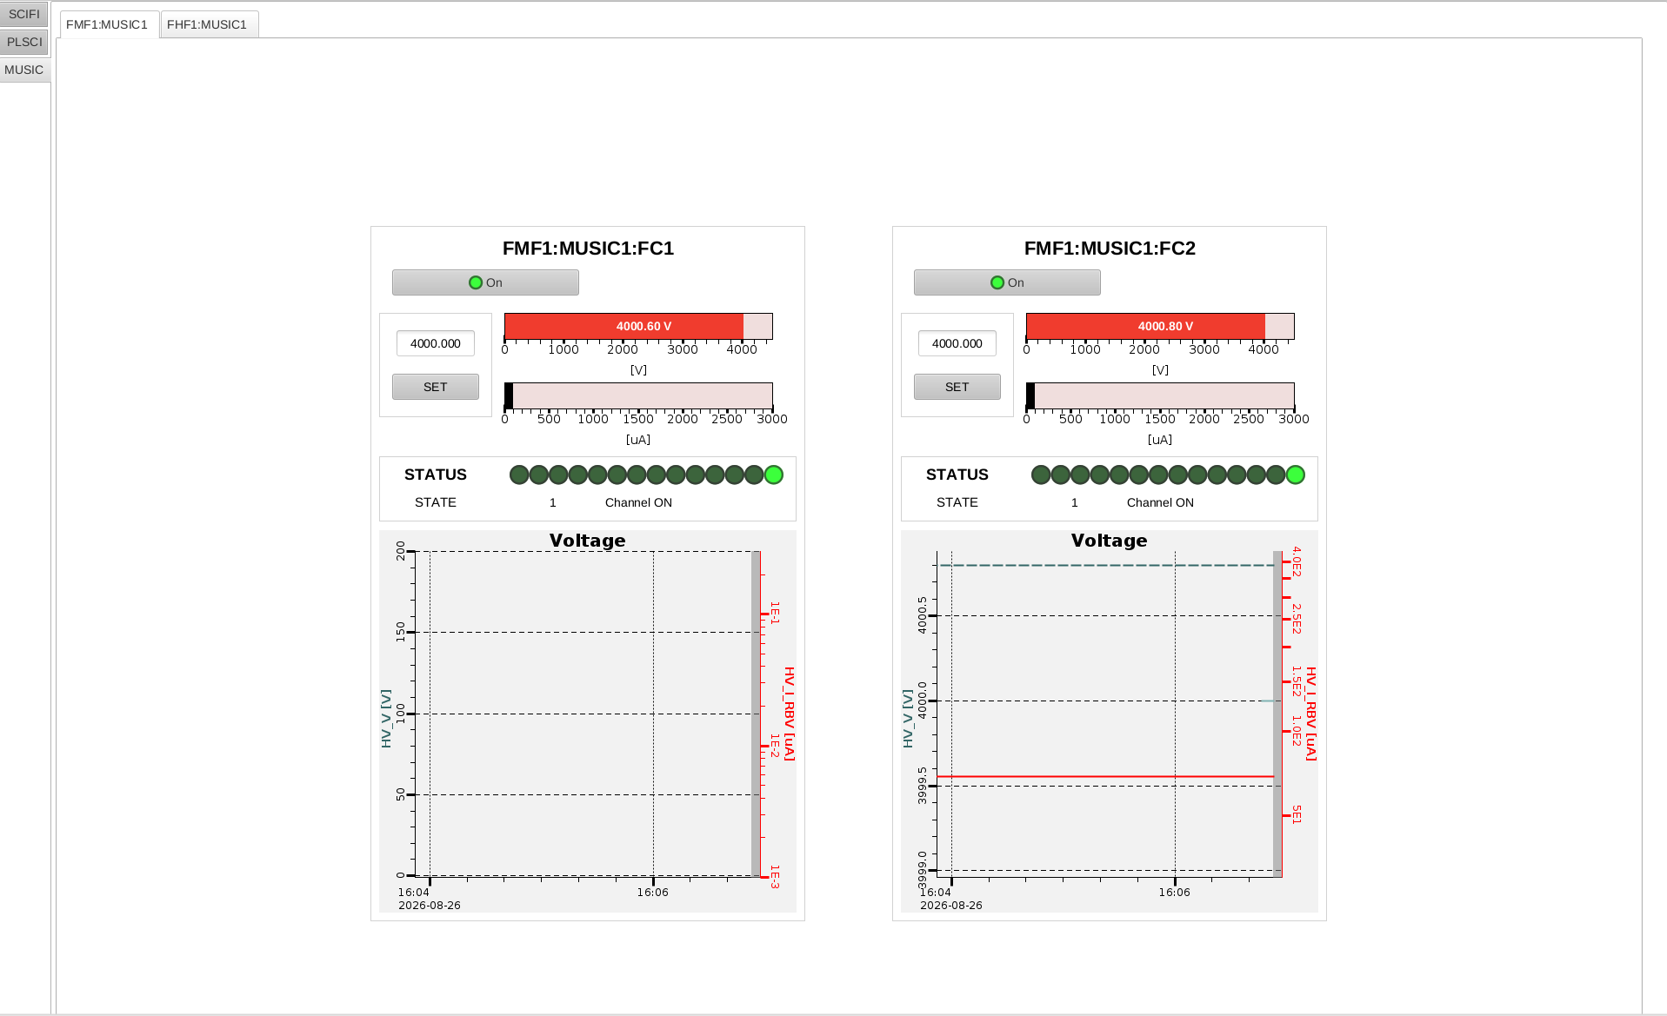
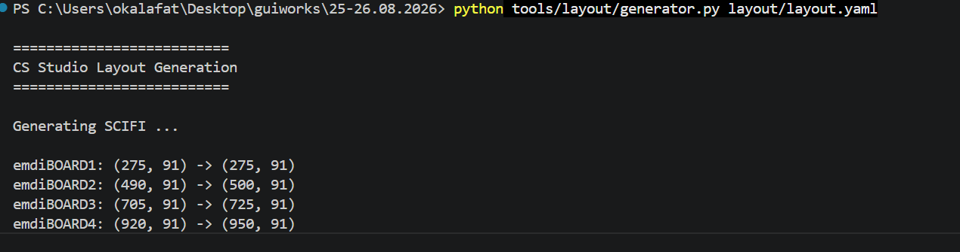
Example – Day 11-13

Slide 23
Report 26.08.27
Suggested
to think click a button to open a new tab
there will come one more HV for pos values (I put the new section for 2nd power supply of MUSIC but there is no PV in EPICS for now)
make settings file that will be automatized later when we have different layout ideas
naming and README files should be done like MUSIC
add set button for scifi bias set
meet with Irakli talk about feedbacks (Irakli two weeks absence,told me focusing on EPICS system fundamentals for this period)
Questions / Ideas
multistate leds make error, warning, ok
for plsci it may be used tank/progress bar for HV_I_RBV

Slide 24
Report 26.08.31
Suggested
to think click a button to open a new tab
look the fundamentals of EPICS ?
Questions / Ideas
multistate leds make error, warning, ok
for plsci it may be used tank/progress bar for HV_I_RBV

Slide 25
Report 26.09.01
Suggested
to think click a button to open a new tab
look the fundamentals of EPICS ?
SFC presentation
Questions / Ideas
multistate leds make error, warning, ok
for plsci it may be used tank/progress bar for HV_I_RBV

Slide 26
Report 26.09.02
Suggested
to think click a button to open a new tab (Status information box will be tried today)
look the fundamentals of EPICS ? (one document from jan)
Questions / Ideas
multistate leds make error, warning, ok
for plsci it may be used tank/progress bar for HV_I_RBV

